Slide 1

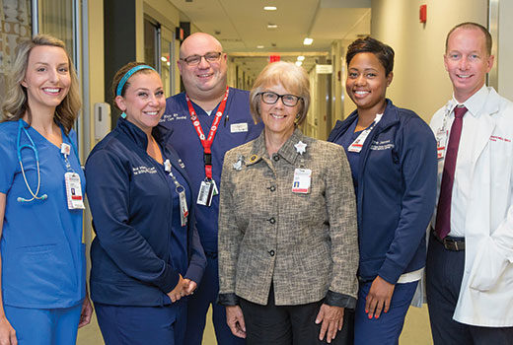
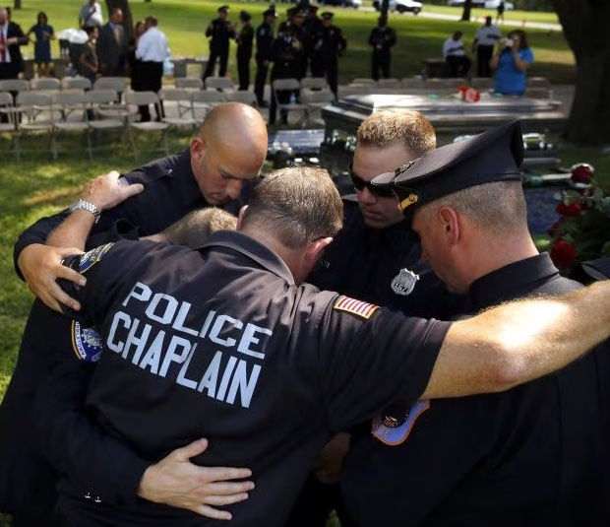
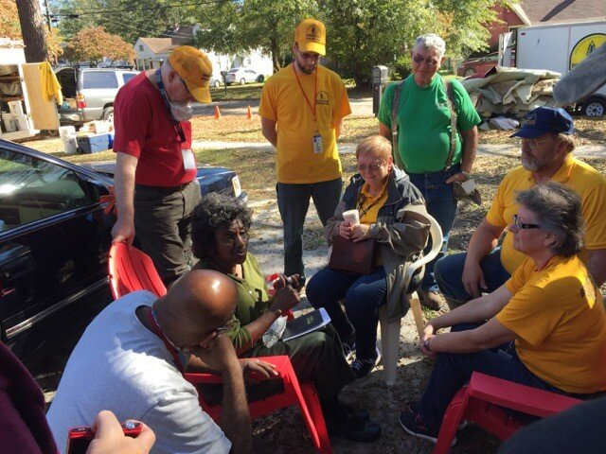
SBC Chaplaincy Update
Doug Carver
Executive Director of Chaplaincy
North American Mission Board
Annual SoCal Chaplain Training
Anaheim, CA
Mar 4-6, 2024

Slide 2
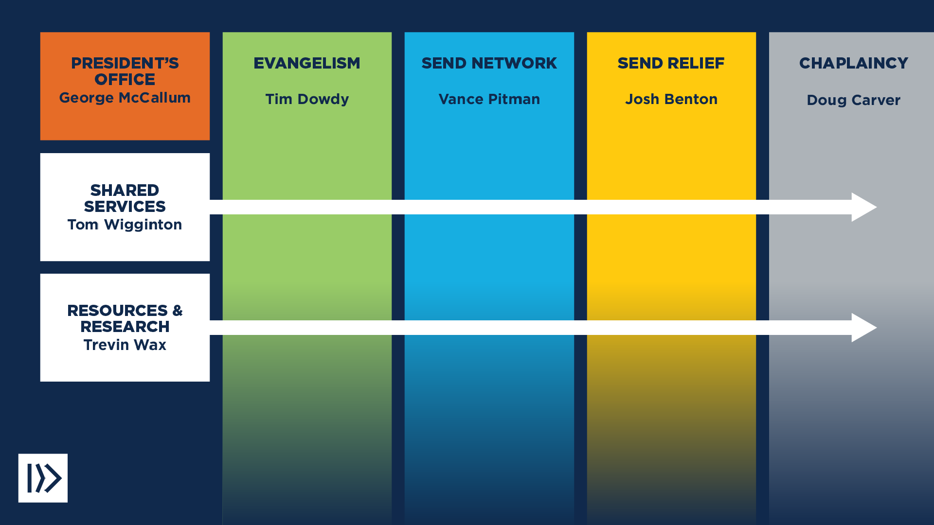
NAMB ORGANIZATIONAL CHART

Slide 3
SBC MINISTRY ASSIGNMENTS TO NAMB
Establishment of new congregations -10,000 since 2010
Evangelism – Regional training, GenSend, Crossover
Appointment and Support of Missionaries – 6300 endorsed
Missions and Missions Education – Online courses, podcasts, On Mission
Leadership Development - Refresh Retreats, Leadership Institute
Relief Ministries – Adoption, refugee ministry, fight human trafficking, DR

Slide 4
CHURCH PLANTING RESOURCES
A minimum $56,000 in funding available for vocational church planters
Two-day, in-person orientation and contextualized training
Two years of personal coaching
Access to free, confidential counseling
Free access to periodic national and local events
Ongoing care for the planting couple and their family

Slide 5
CHURCH PLANTING RESOURCES
(Cont’d)
Medical insurance for the planter and their family
Survivor protection benefit and disability coverage for the planter
An initial contribution toward the planter’s retirement
Accounting, payroll and bookkeeping services for the new church
A website and giving platform for the new church

Slide 6
CHAPLAINCY TEAM GOALS
Recruit & endorse the best Southern Baptist chaplains
Provide pastoral care to our 3300 chaplains
Conduct annual SBC chaplain training events
Collaborate with Send Network on church planting near military communities (CPMC)
Support National Military Collegiate Catalysts

Slide 7
Chaplaincy Strength
3,117 Endorsed chaplains
Total Endorsements: 4,307

Slide 8
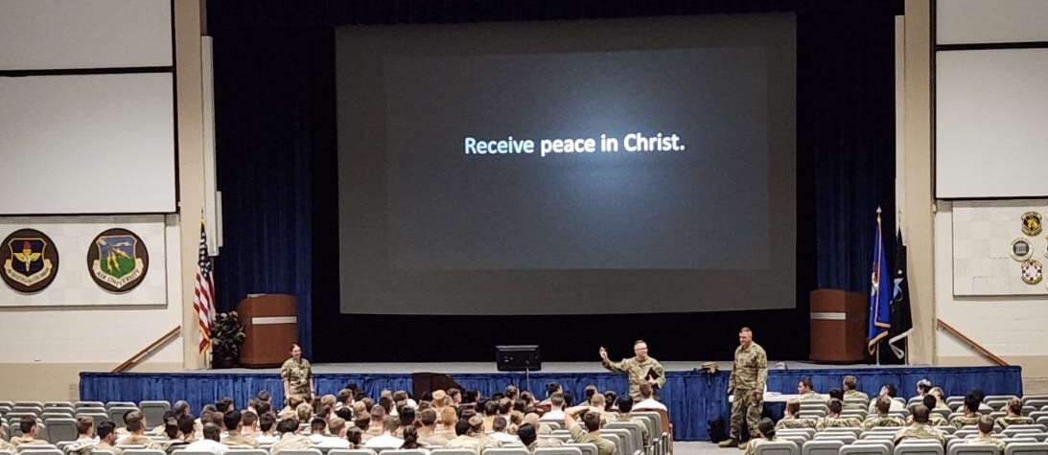
GOSPEL PRESENTATIONS
92,586
As of 2/2024
1,160,895
since 2010

Slide 9
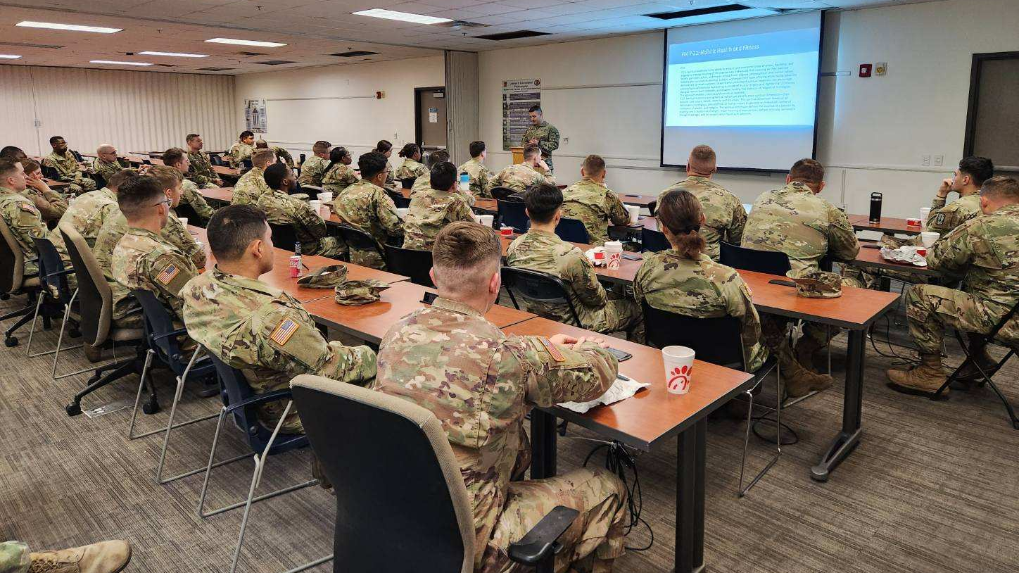
Chaplain-led Professions of Faith
18,140 in 2023
10,157 in 2022
182,800 since 2010

Slide 10
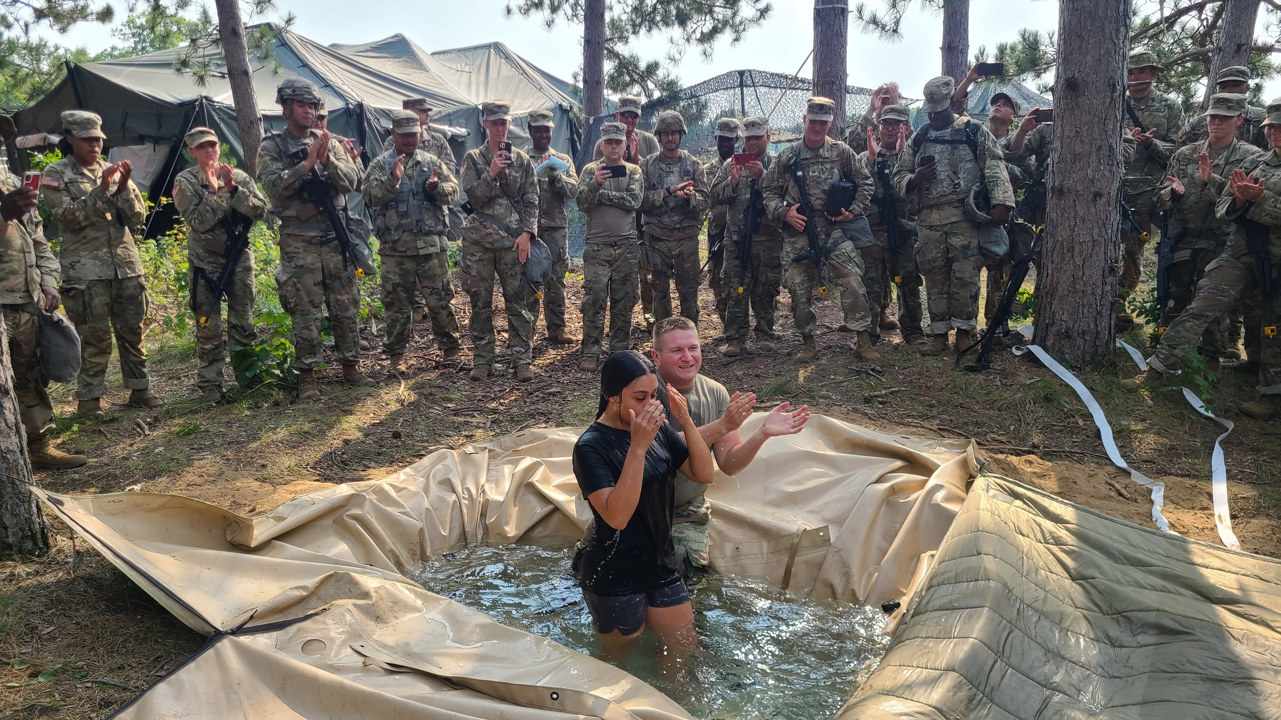
Baptisms by chaplains
1,611 in 2023
36,680 since 2010

Slide 11
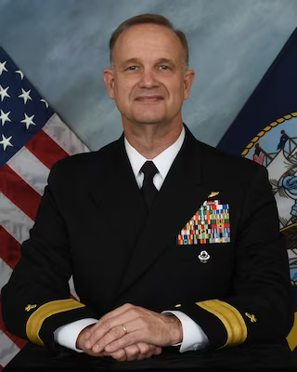
2024 SBC CHAPLAINCY ANNUAL TRAINING
”The Chaplaincy and Godly Character”
Keynote speaker- Dr. Endel Lee
--Visiting Associate Professor, University of Mobile, AL
    Anaheim, CA (Mar 4-6, 2024)
    Ridgecrest, NC (Oct 14-16, 2024)
    ---Speaker TBA

Slide 12
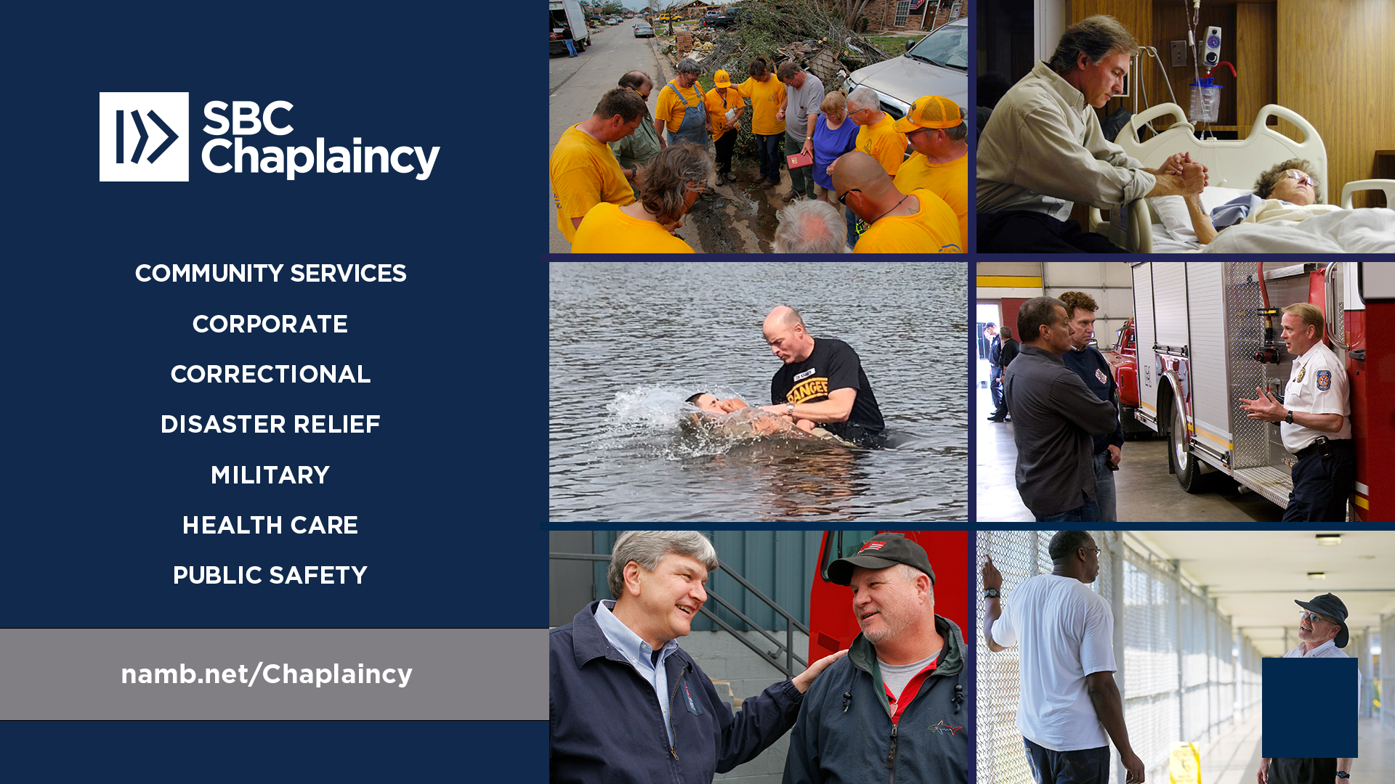


Slide 13
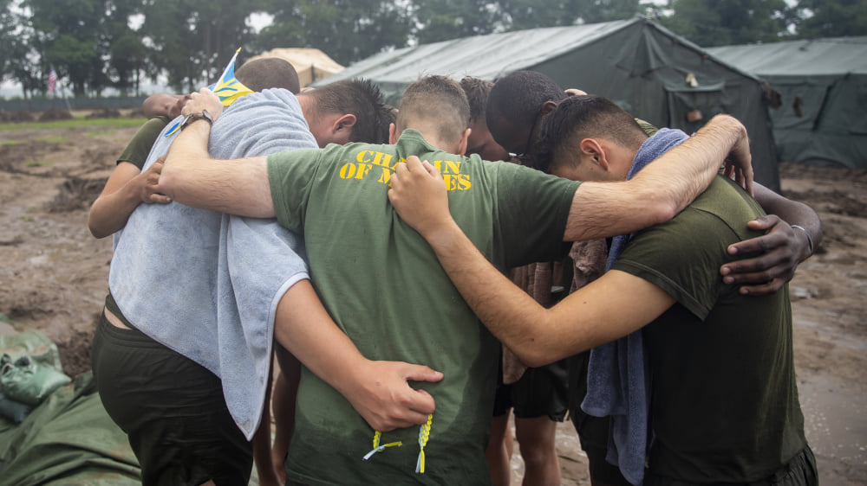
Forward Deployed
SBC Chaplains (70+)

Slide 14
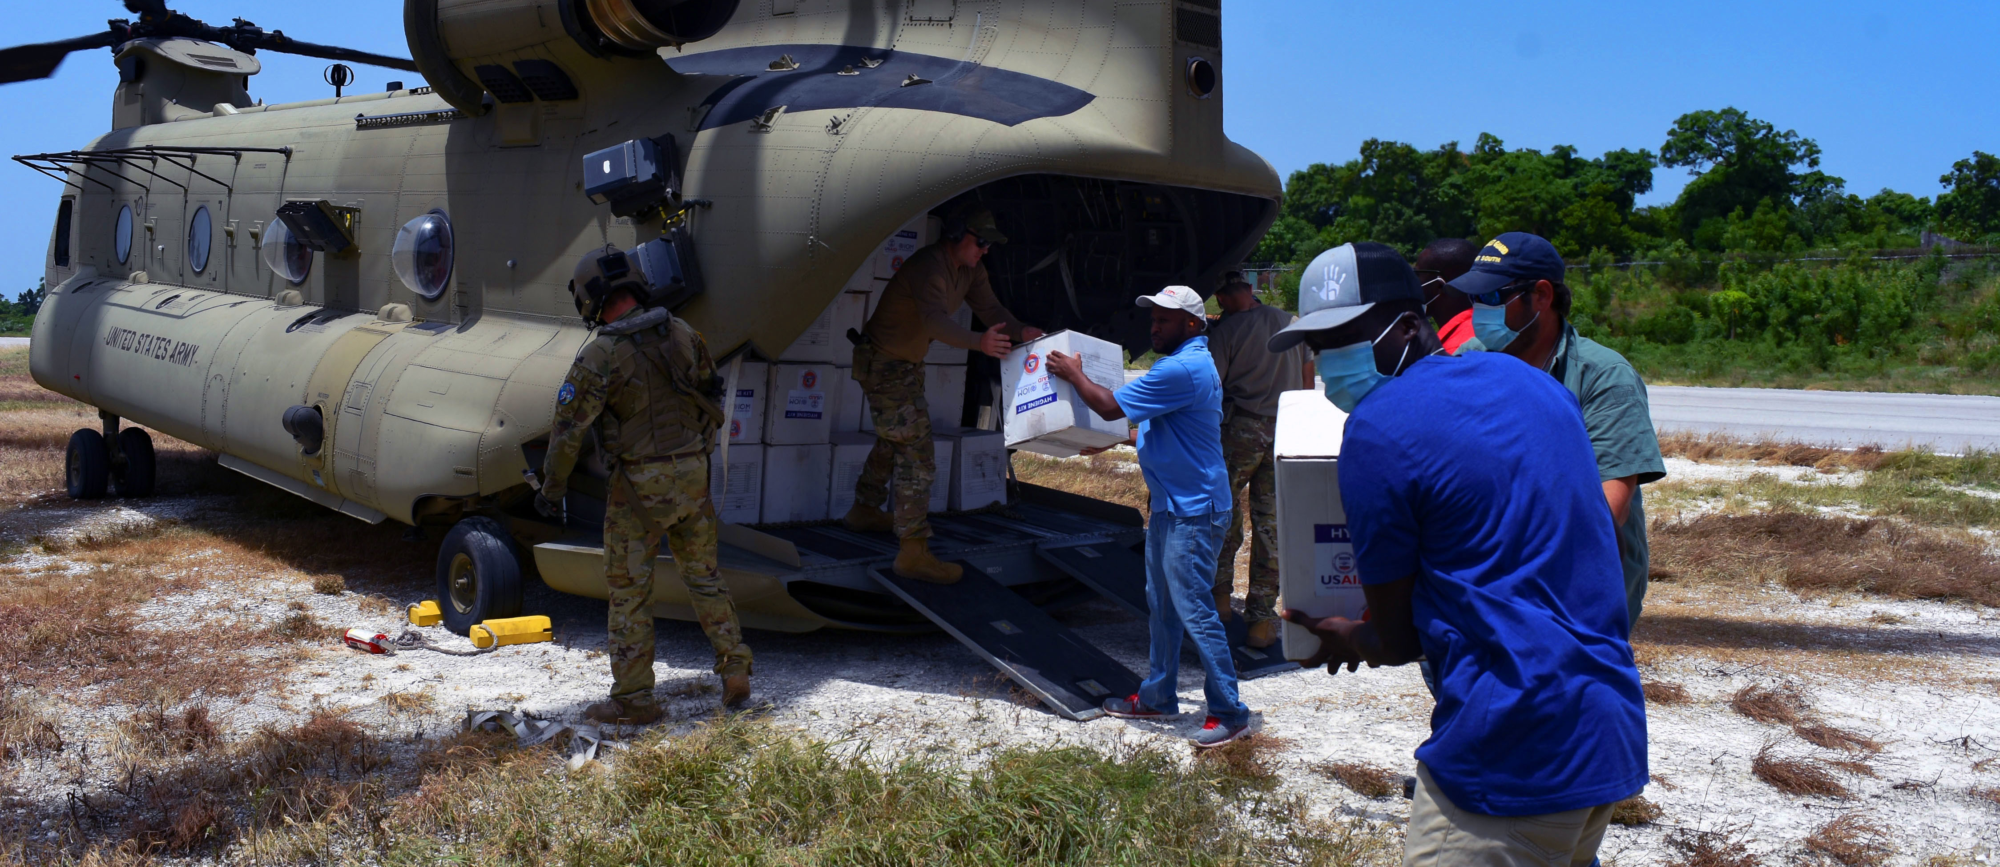
Civil Support Operations in Haiti (2022):
SBC Chaplains (Travis AFB) provides religious support to Airmen & coordinated religious leader engagement with local clergy

Slide 15
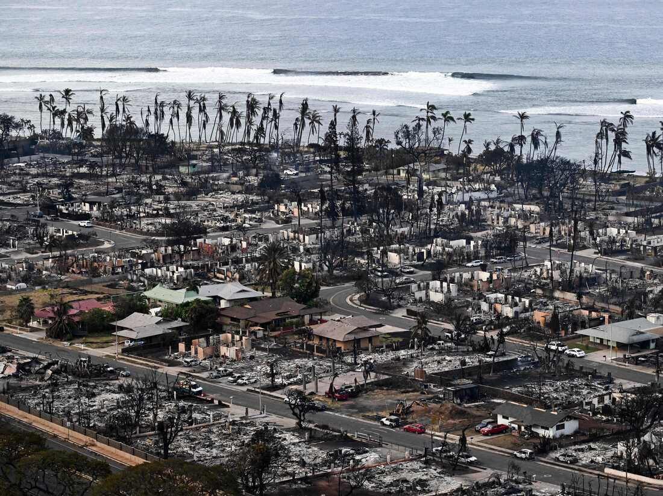

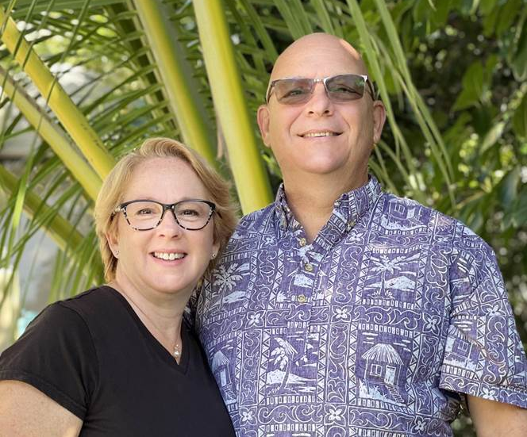
Gay and John Williams
DR Chaplains, HPBC

Slide 16

Monthly Mentorship Roundtables For Chaplain Candidates

Slide 17
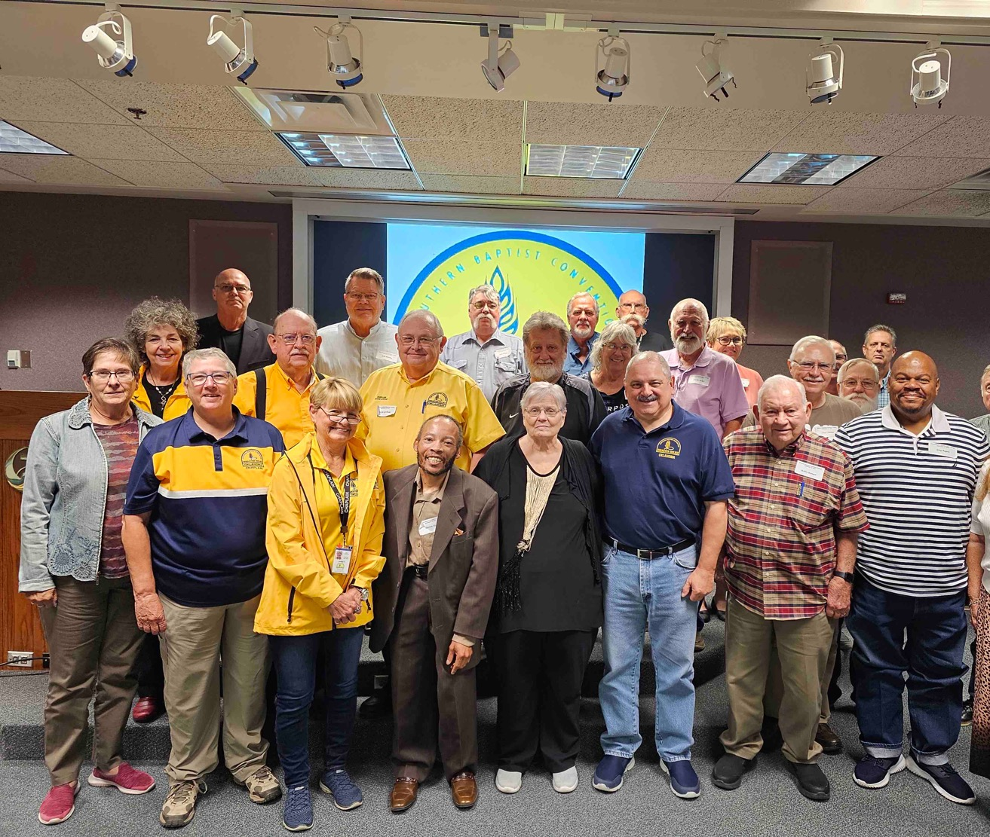
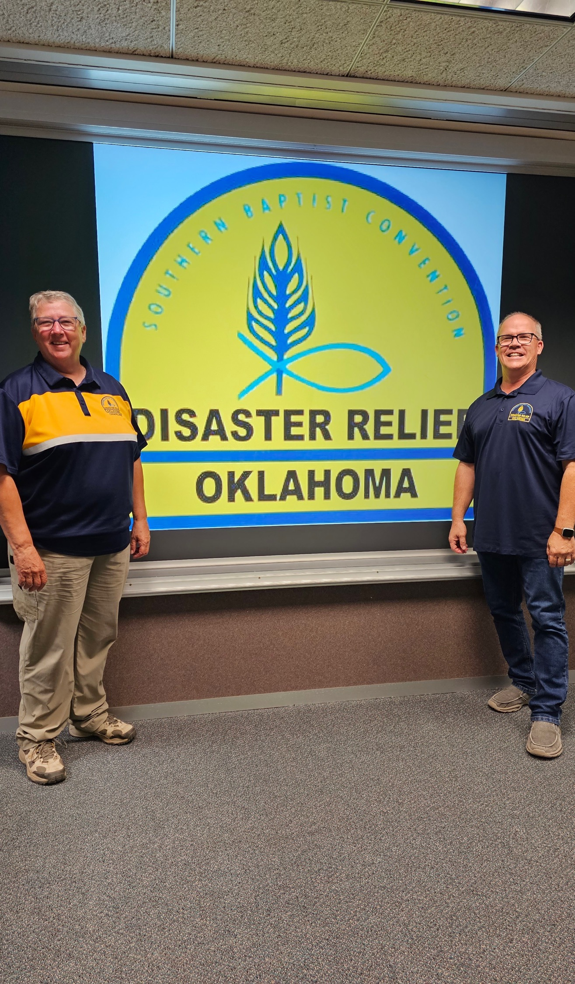
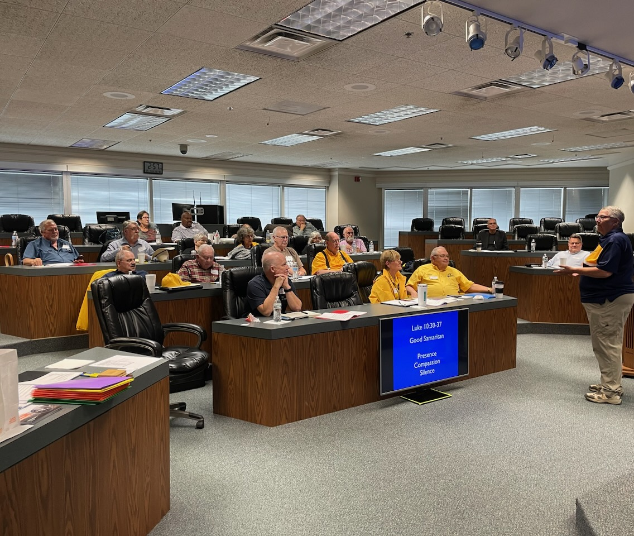
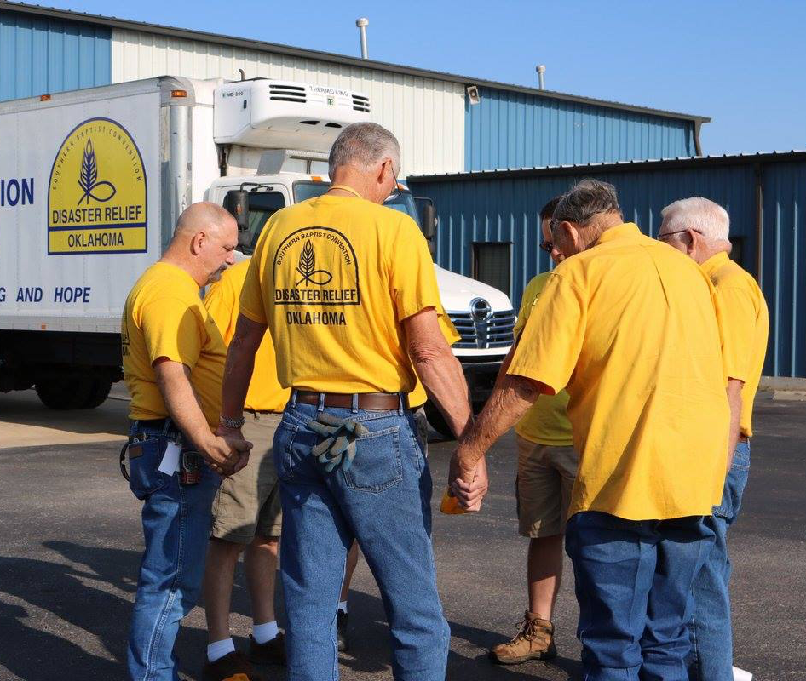
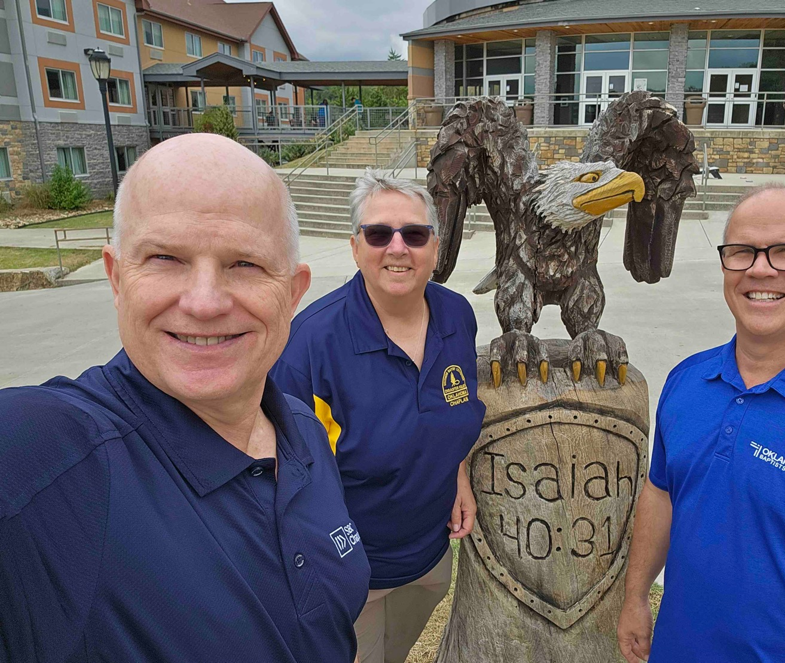
BGCO DR Chaplaincy
Refresher Training

Slide 18
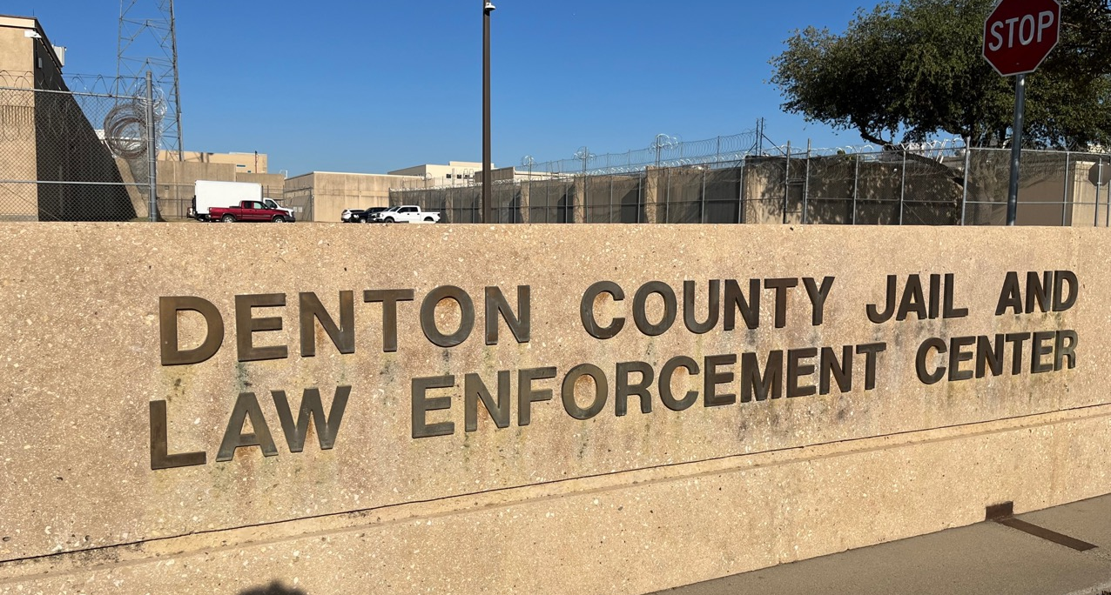
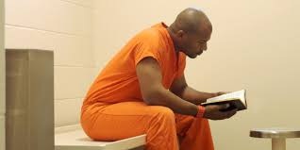
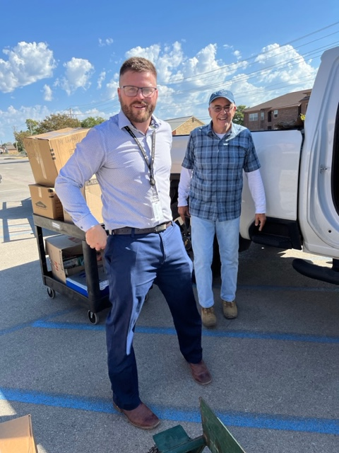
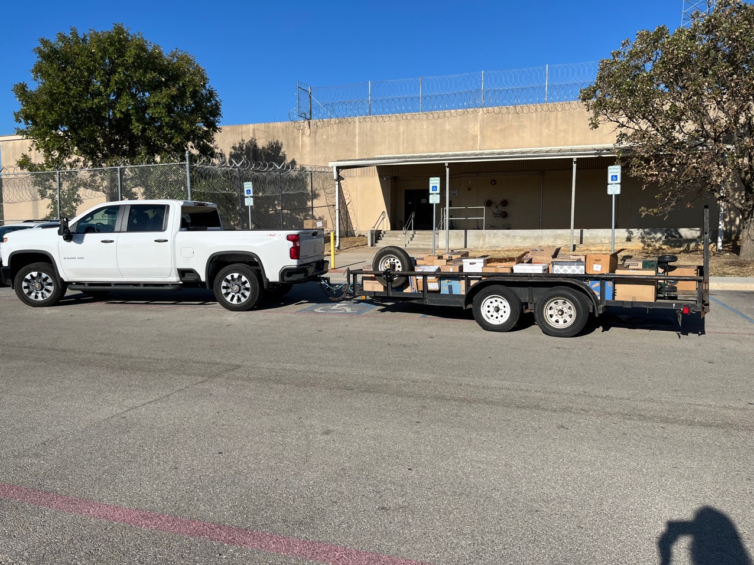
David Umfreville
Correctional chaplain

Slide 19
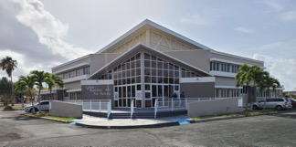
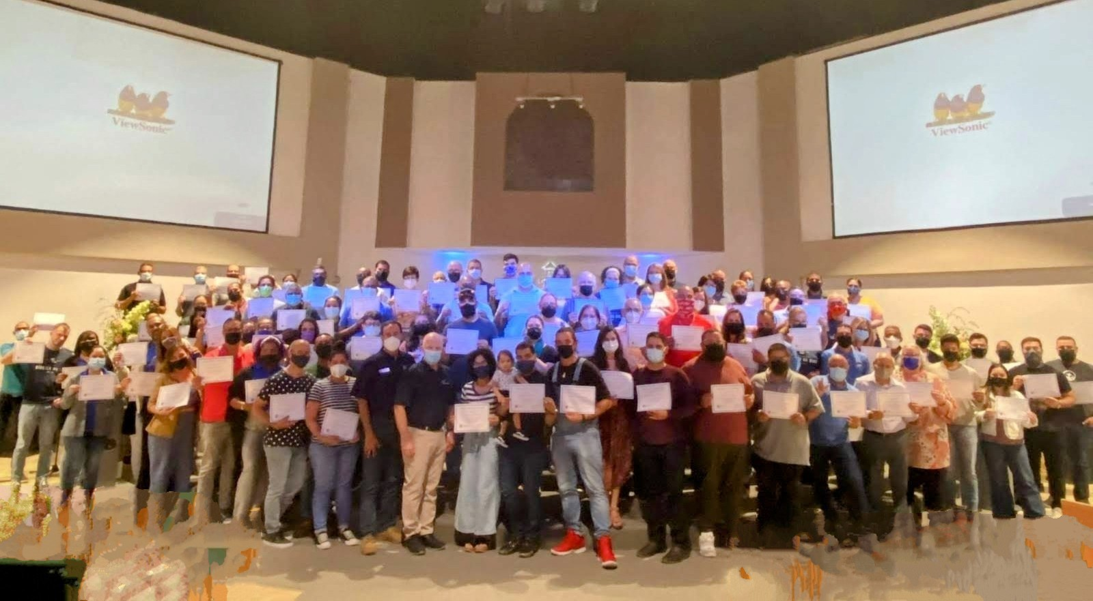
Public Service Chaplaincy Ministry in Puerto rico
Iglesia Bautista Sin Paredes
- SBC General Chaplaincy Conference location
110 Puerto Ricans who received their certificates of training for General Chaplaincy upon completion
Notes:
WHERE: Guayama, Puerto Rico
WHEN: May 20-24, 2021
IMPACT: An historical training event providing basic chaplaincy
training to 110 people from South Puerto Rico to introduce them to
SBC chaplaincy to begin their chaplaincy pathway with the Puerto
Rico Baptist State Convention. Brent Bond facilitated the two-day training with an interpreter.

Slide 20
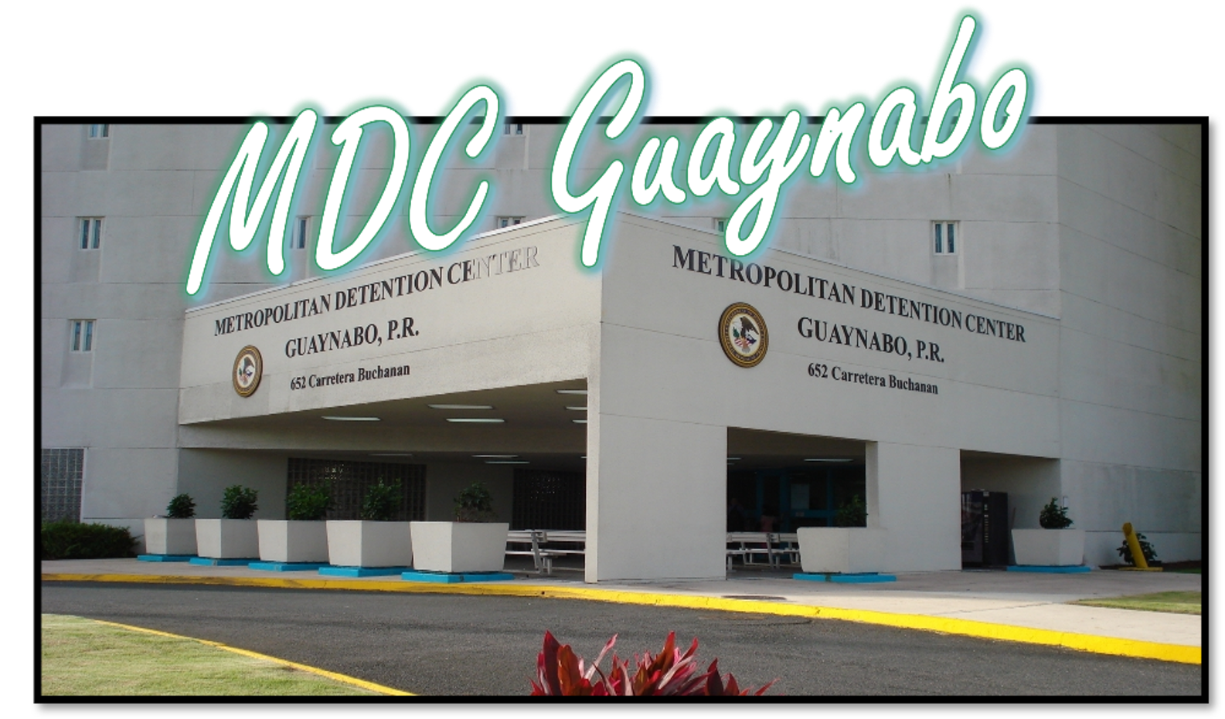
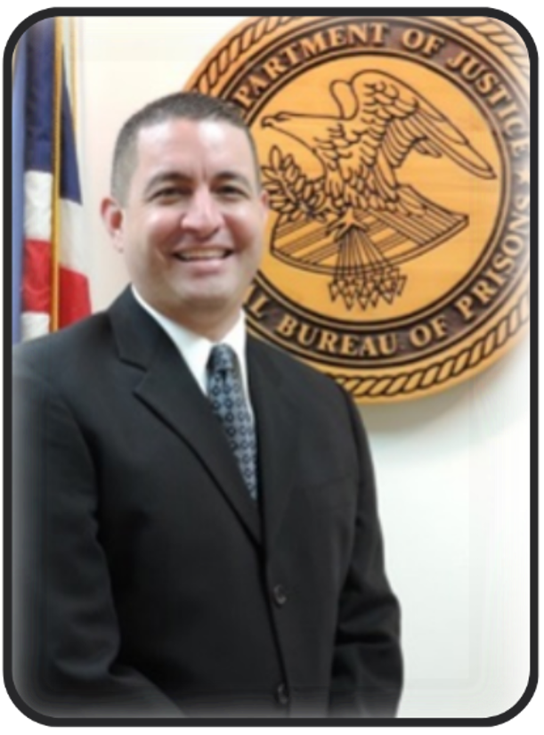
Federal Correction Ministry in Puerto rico
Juan E. Cintron
Notes:
-Chaplain Juan E. Cintron is the BOP (Federal Bureau of Prison) Chaplain in PR and serves as a Protestant Chaplain to serve more than 1,200 inmates. Detainees are from all of Central and South America (Dominican Republic, Jamaica, Haiti...)
-He begins his ministry in October 2001 (23 years).
-Juan is the Supervisory Chaplain and the Department Head who coordinates religious care for the inmates.
-Personally provides 11 weekly protestant services and various counseling services.
-Juan's testimony: "During these twenty-two years of ministry, I have seen the work of God in an amazing way. The need of the Gospel is so important that we need to preach Christ not only with words, but through our daily living and work ethic. The best way that we can have an impact in a prison setting is by giving the Love of Christ. Adults in custody present a great challenge since they are not abiding by any law or regulation. Been incarcerated means a loss of privileges and freedom. They need to learn new habits and some time they go back to their religious childhood roots. There is a need of Christian and Biblical teaching, to eradicate the sin of their hearts and having Jesus as they lord and savior."

Slide 21
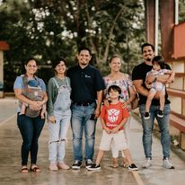
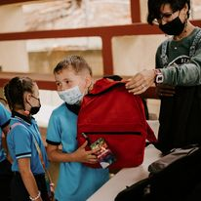
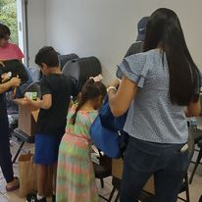
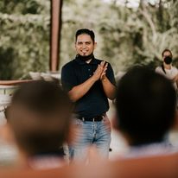
Public Service Chaplaincy Ministry in Puerto rico
”We impact our community through school chaplaincy. We went to the school to preach the gospel to kids and teachers. Then we prayed for each one.”
~Luis Rodriguez
community services chaplain and Pastor
Notes:
As we prepare to launch Iglesia Bautista Raham Aibonito in Aibonito, PR we start to impact our community school through chaplaincy. We pack some backpacks with school supply for children from 2nd to 4th grade. The backpacks were provided to us by Send Relief PR. We went to the school preach the gospel to kids and teachers and then prayed for each one of those people. Then we proceed to give the school supply and backpacks.
We stayed a little bit more time with the teachers and they were very thankful that a chaplain alongside with the local southern Baptist church came and visited them.

Slide 22
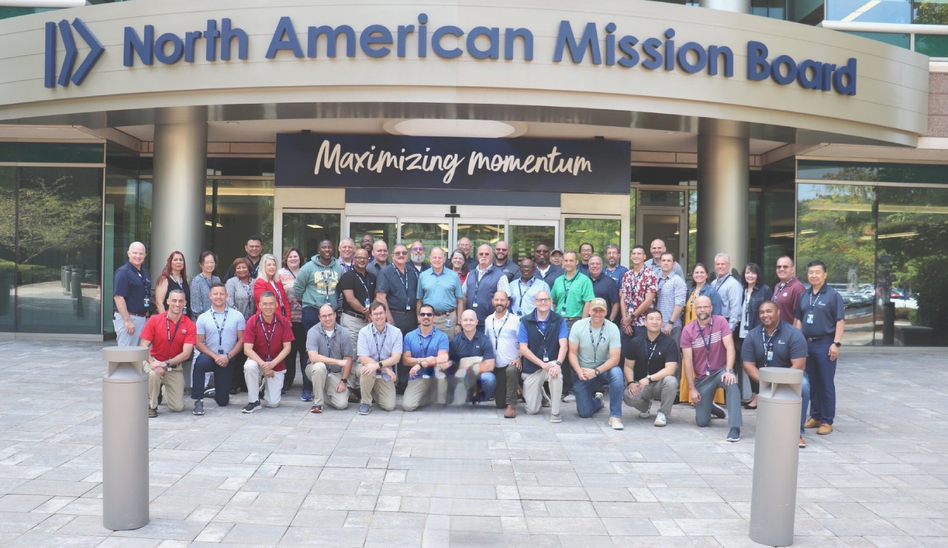
New Chaplain Orientation | August 2023
32 New SBC Chaplains attended:
15 Federal Chaplains
17 Public Service Chaplains

Slide 23
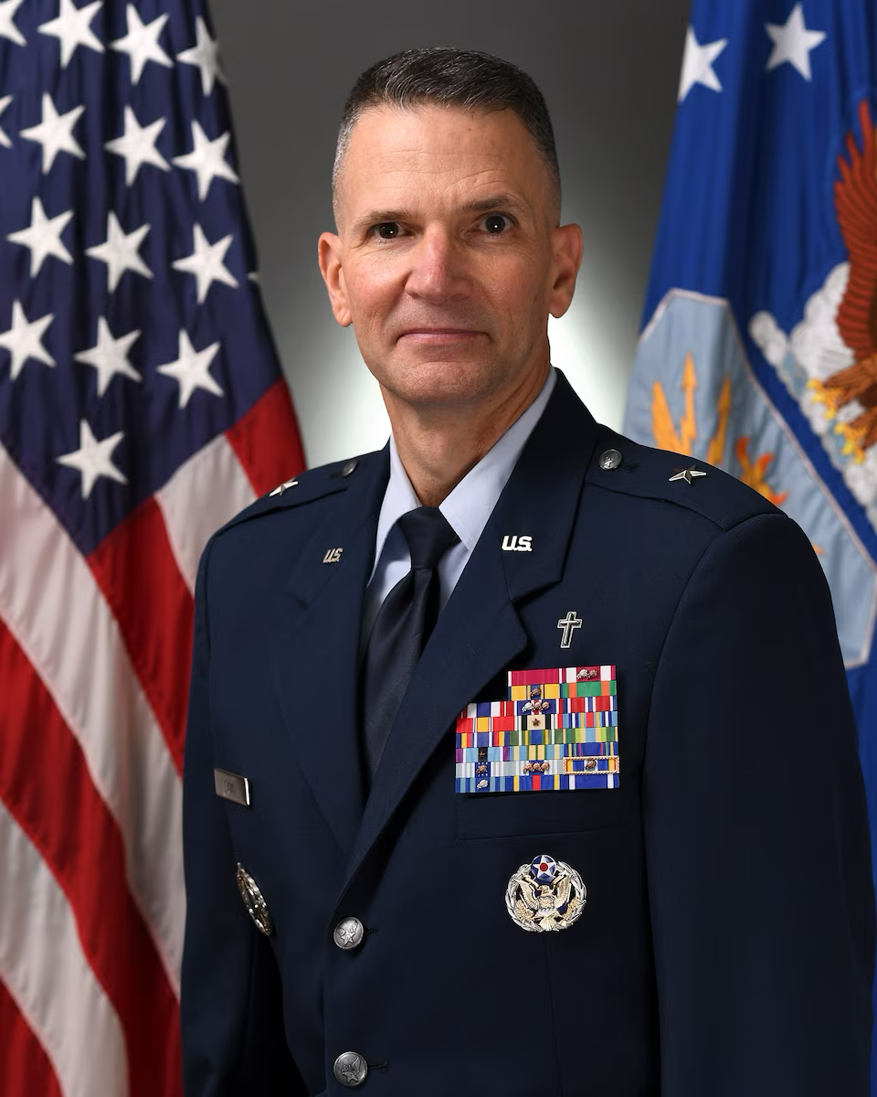

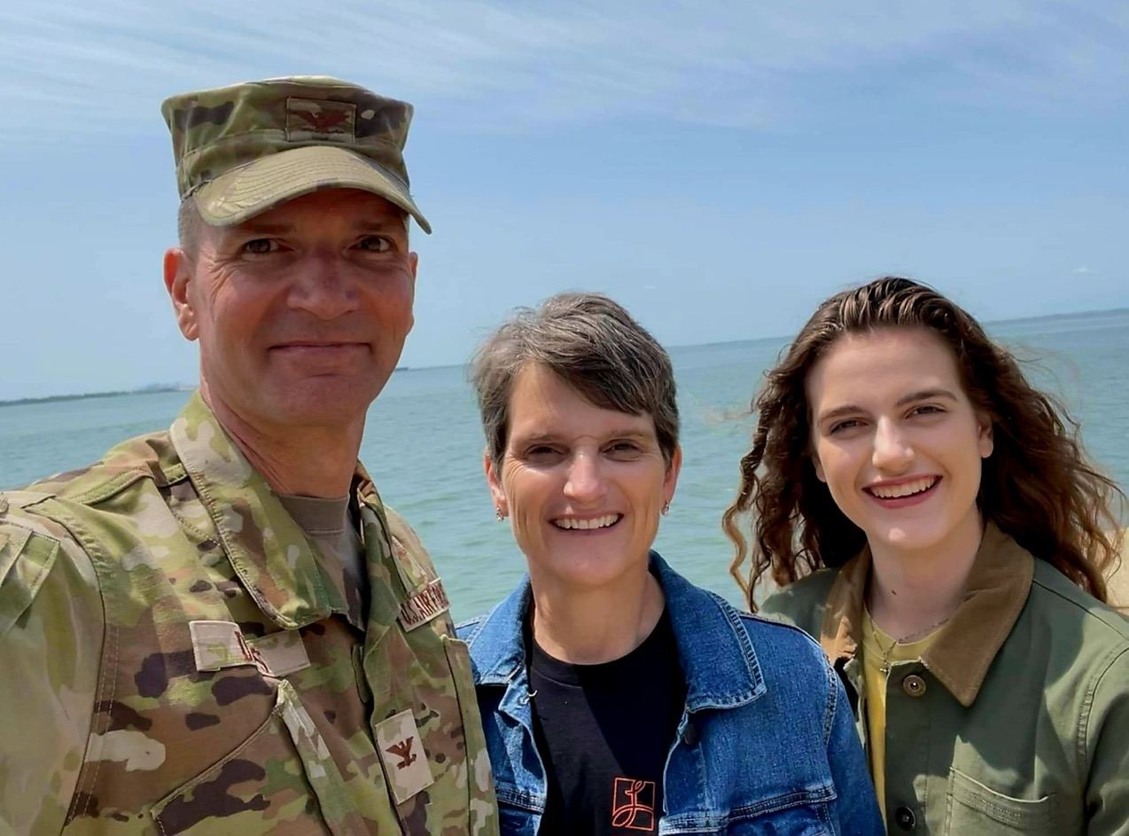
Chaplain Brigadier General-P
Trent C. Davis
USAF Deputy Chief of Chaplains
Trent, Lisa and Hannah Davis

Slide 24
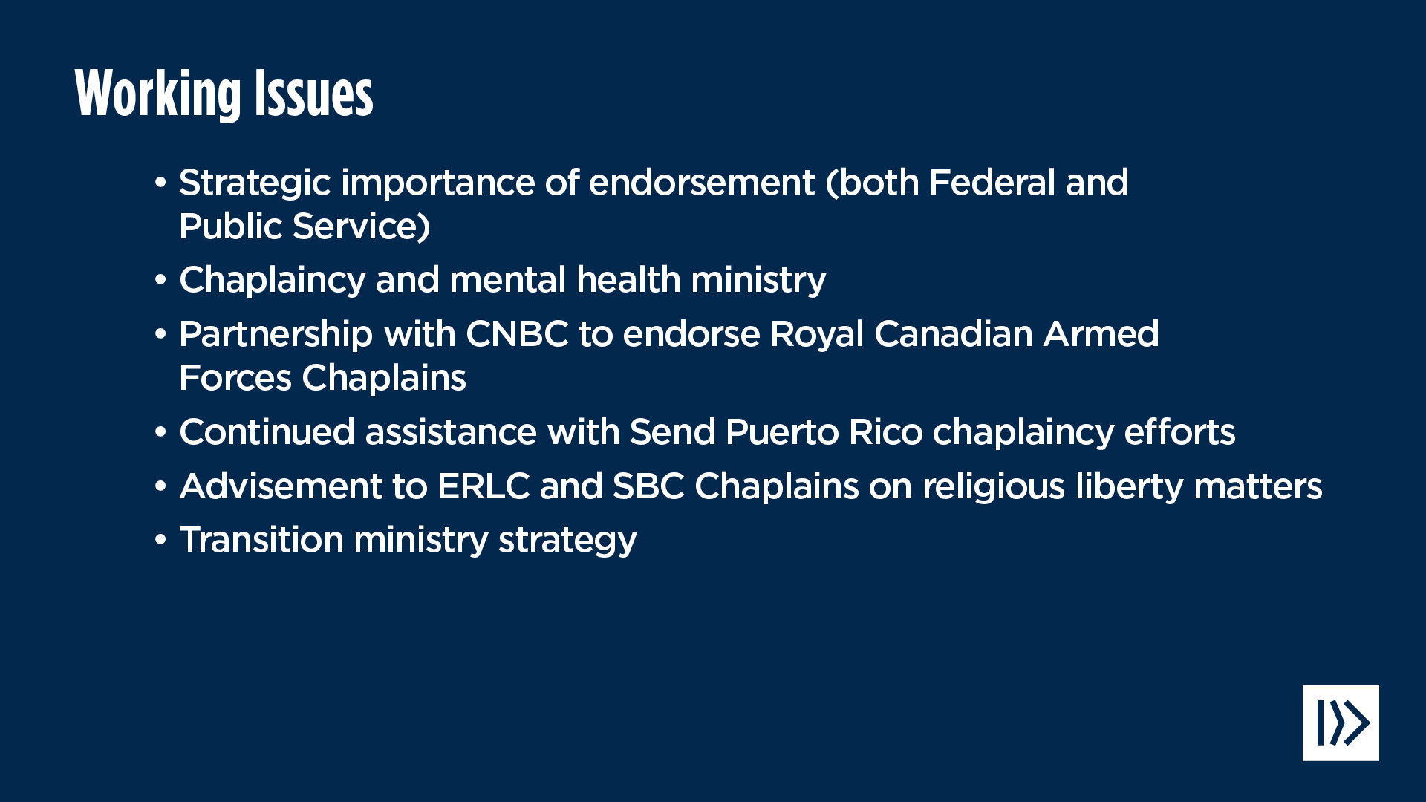

Slide 25


Slide 26
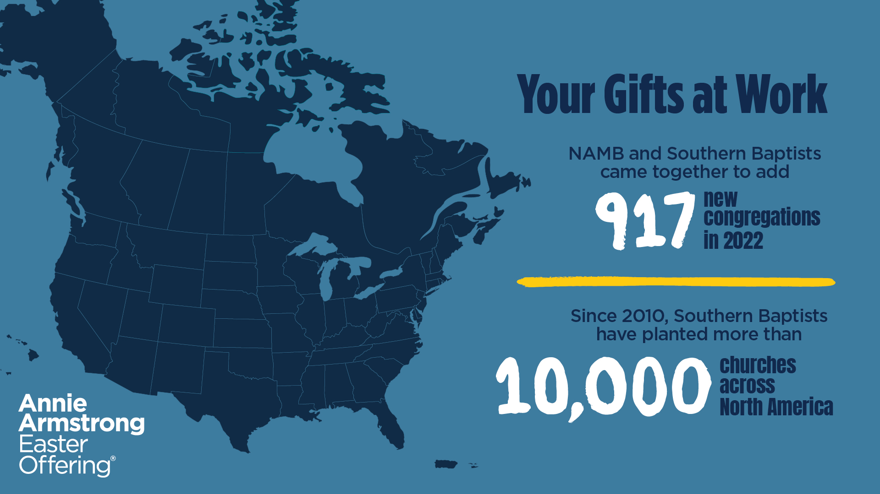

Slide 27
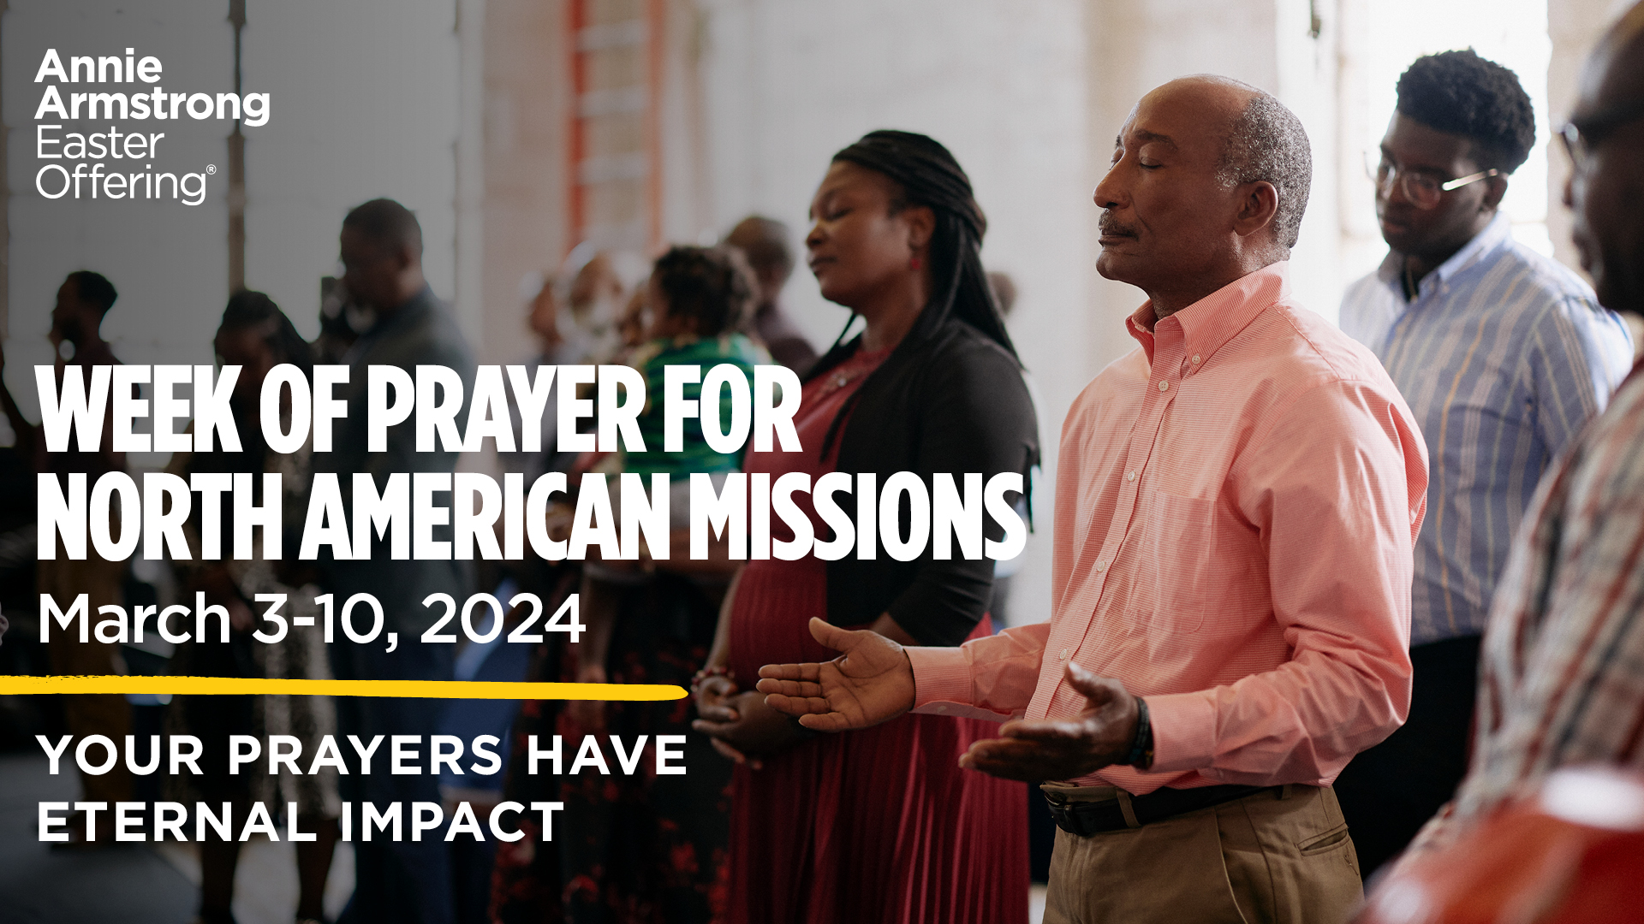

Slide 30
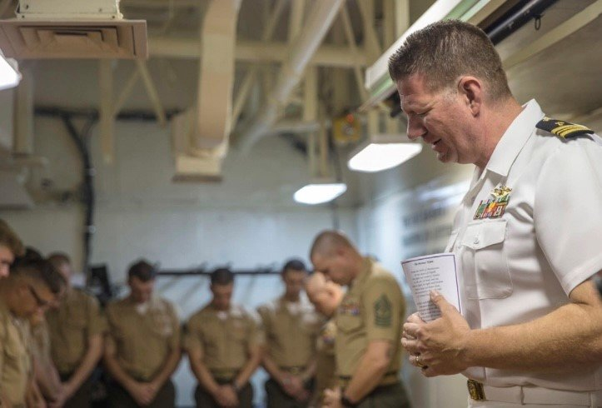
Pray For the Peace of Jerusalem
Psalm 122: 6-9

